Slide 1
Software Architecture
A practical approach

Slide 2
Why do we need Software Architecture?
  Every system is constructed to satisfy an organization’s business goals
  Architecture is a bridge between business goals and the final resulting system

Slide 3
Approach
This is DIFFERENT!
We will not treat requirements as separate from the technology/ implementation
We will weave the concepts and importance of requirements into the Architectural process
We will, actually, start with Architecture and Architecture concepts – then relate requirements back to what we learn in Architecture.
The goal is to have a more ‘real world’ approach to Architecture and how requirements relate to Architecture
The goal is to ensure you understand the foundational elements of what makes software work, so you can then actually create software that DOES work (well).
The desired approach is to have hands on activities that give you a more visceral feel for how architecture shapes what Software Engineering is about
Yes, you will have to ‘write’ … but you will also have to ‘create’, and learn
Notes:
i.e. Traditional approach is spend weeks on requirements & theory of requirements; then spend weeks on arch and arch theory. We will take a more hands on approach

Slide 4
So you think you can code?
But do you understand what you are doing?
Do you understand WHY your code works?
Do you understand HOW it works?
Do you understand all the pieces that come together to make it work?
It’s all architecture
Until you understand the architecture, you can’t really build powerful applications with your code.

Slide 5
What is Software Architecture
The software architecture of a system is the set of structures needed to reason about the system. These structures comprise software elements, relations among them and the properties of both.
?
Notes:
The software architecture of a system is the set of structures needed to reason about the system. These structures comprise software elements, relations among them and the properties of both.
Architecture is an abstraction – We select and focus on certain details in the system. We do this to manage complexity
Architecture is a set of software structures:
Module Structures – the static design of the system
Component-and-Connector Structures – describe the dynamic aspects of the system
Allocation Structures – how the software maps into non-software entities, think about how a system is built.
Architecture is design, but not all design is architecture – many design decisions are unspecified by the architecture

Slide 6
Architecture is a set of Software Structures
No single structure defines the architecture
There are three broad categories of structures:
  Module Structures – the static design of the system
  Component-and-Connector Structures – describe the dynamic aspects of the system
  Allocation Structures – how the software maps into non-software entities, think about how a system is built.
We will discuss these in detail throughout this course
Notes:
Metaphors – a software architecture is a symphony, you are the conductor and the collection of software elements are the instruments. Your objective is to get them to work together and make beautiful music.

Slide 7
Architecture is about Behavior
Software structures provide the physical building blocks of the system.
But, to fully capture a system we need to describe how it is supposed to perform
  Who/what does it interact with?
  How does it behave in response to specific requests?
  What does it respond when something goes wrong?
  Understanding, capturing, documenting and ensuring that these ideas are carried forward into the implementation is Software Architecture.

Slide 8
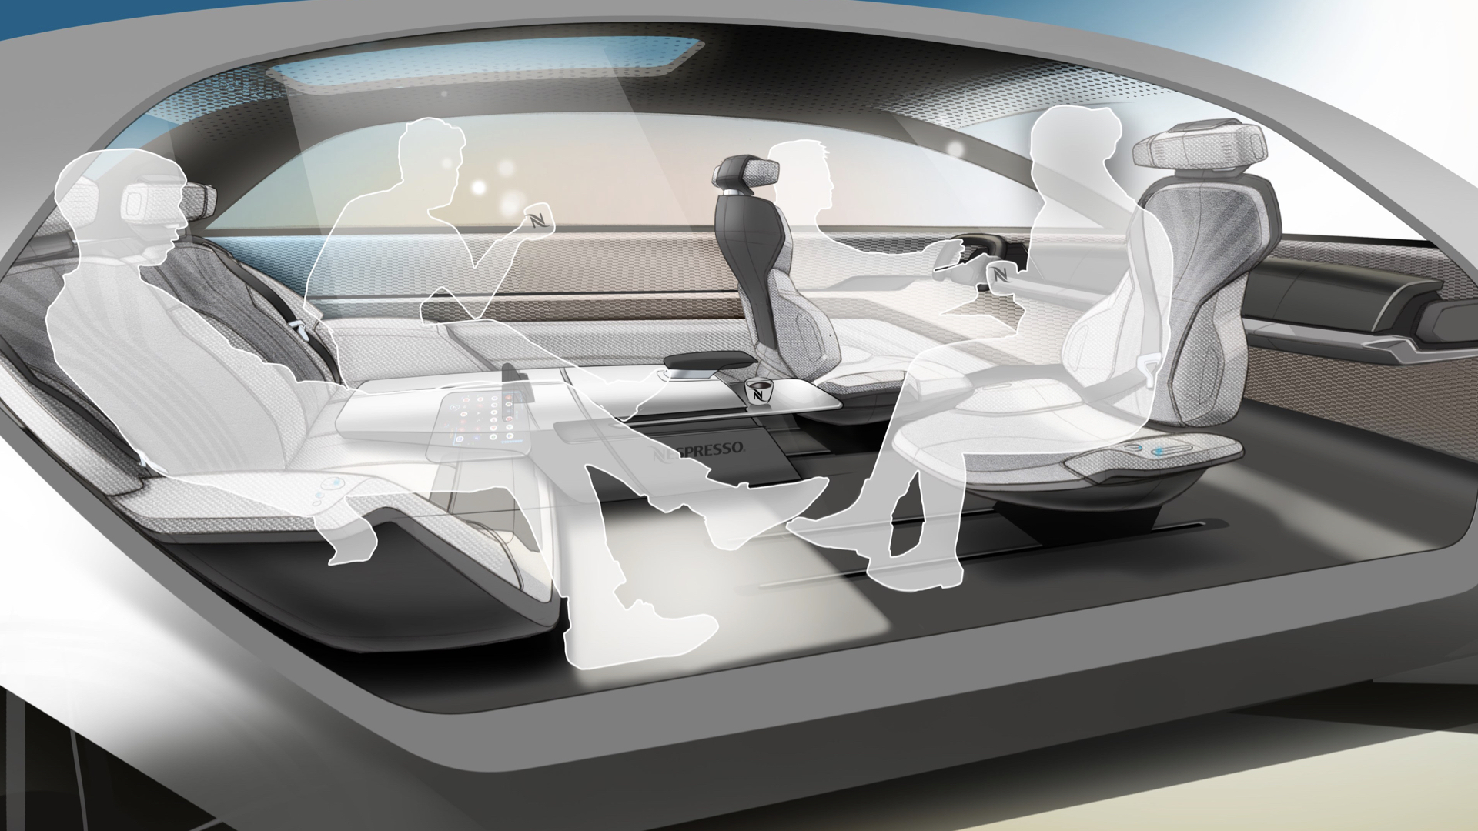
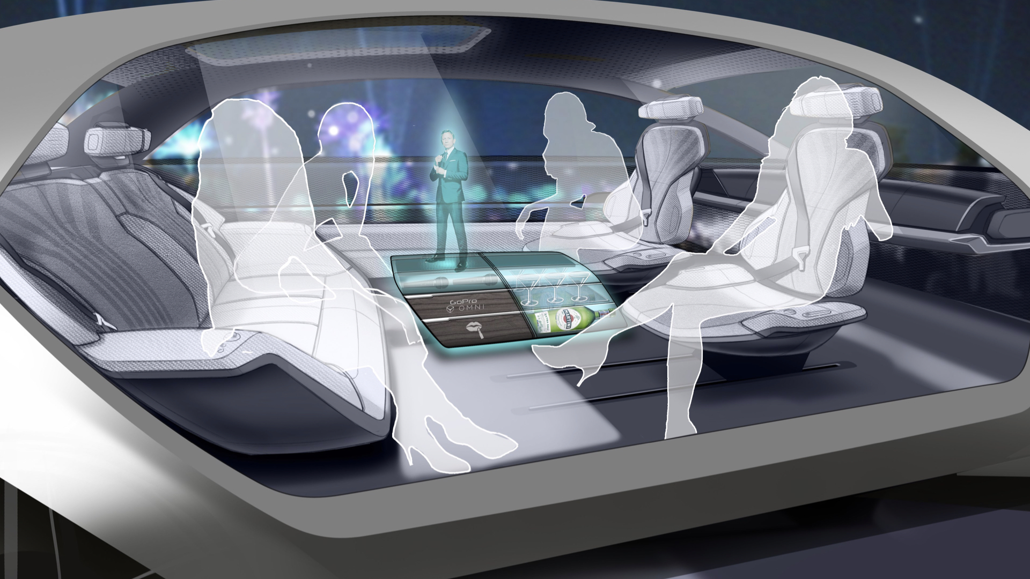
Concept Car – understanding behavior
Designing an autonomous car interior for endless possibilities
For Grammer AG, a leading interior component supplier, we defined a vision on how semi-autonomous car interiors might look for the next generation of cars with Level 4 Autonomy.
https://www.granstudio.com/grammer

Slide 9
Architecture is an Abstraction
  An architecture selects certain details and suppresses others
  Architecture is concerned with the public facing portion of the system
    APIs
    Public Classes
  Abstraction is essential to taming the complexity of an architecture
  Metaphors can provide good tools for abstracting away complexity
    Desktop Metaphor – Alto, Viewpoint, MacOS, Windows, Gnome

Slide 10
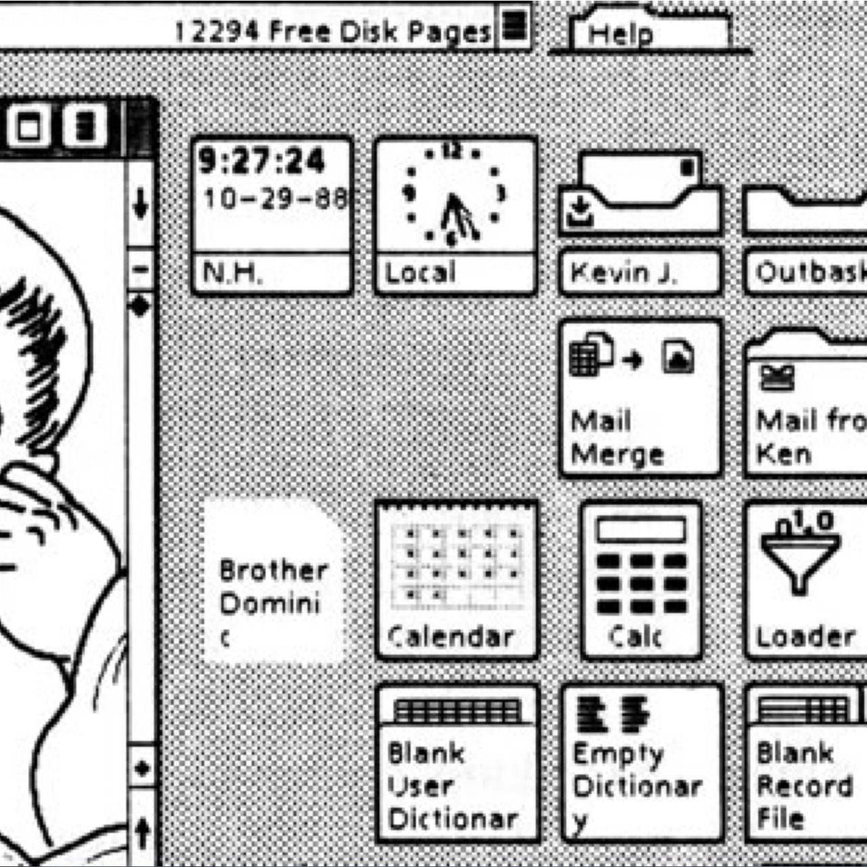
Example
You probably don’t recognize this version of a desktop metaphor, but
  You know what each of these icons does, or at least can make a good guess
  Good software architecture metaphors work the same way
  Patterns are an area in software architecture that is rich in metaphors:
  Pipe & Filter
  Blackboard
  Etc.

Slide 11
Observations:
  Every software system is constructed to satisfy an organization’s business goals
  Architecture is a bridge between business goals and the implementation of a system
  Every software system has a software architecture
Notes:
There is a chain here -> software is needed to achieve an end goal -> requirements specify and clarify that end goal -> an architecture provides the blueprint to get from the requirements to the goal

Slide 12
The Benefit of Good Architecture
Increase
Value of reuse
Requirements
Architecture
Design
Code
Cost of defects
Increase

Slide 13
What Makes a “Good” Architecture?
Product (Structural) Guidelines
Well defined functional modules using information hiding, and separation of concerns
  Encapsulates changeable aspects to facilitate change
  Enables independent concurrent development by separate teams
Quality attributes achieved using well-known architectural patterns and tactics specific to each attribute
Limited dependencies on a particular technology or commercial product or tool
Technical
Process

Slide 14
What Makes a “Good” Architecture?
A well thought-out architecture must consider these important principles:
Build to change instead of build to last
Understand the end user needs and the domain before designing components
Identify sub-systems in your product and consider layers and components to abstract them and identify the key interfaces
Use an incremental and iterative approach to designing the architecture
Learn from history, document your decisions and identify and mitigate key risks
Do not under-invest in architecture
https://www.infovista.com/blog/the-importance-of-software-architecture

Slide 15
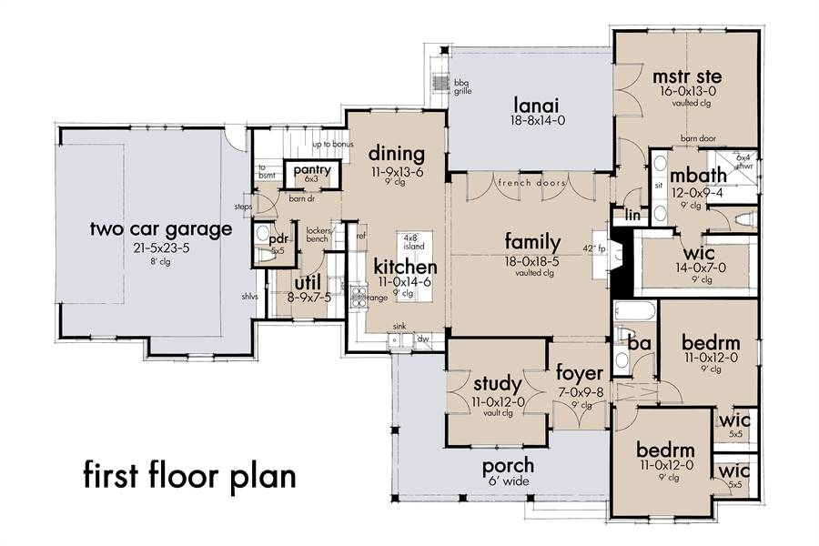
Architecture of a house
When you build a house:
You lay out things like:
Foundation structure
Framework (rooms, doors)
Wiring, plumbing
Then builders follow the instructions to put up blocks, timber, walls etc.
How does the architect know what to tell the builders?
They ask the client (Requirements!)
Similar with Software
https://www.thehousedesigners.com/plan/mill-creek-farm-7844/

Slide 16
What type of requirements matter to Architecture?
Does the architect need every detail?
No, only things that affect the architecture
Examples: # of stories; # rooms; position of house relative to sun; local regulations/ ordnances; geographic location (hot/ code); type of heating; open spaces desires
Examples of don’t care: Paint color; trim types; kitchen appliances; …

Slide 17
ASRs
In houses, architects need to understand the physics and science that are behind the decisions and impacts of their decisions (load, stability, safety, aesthetics, …)
In software you need the same thing. Understand what is behind all the possibilities for arch. choices and decisions and understand the implications with each choice.
There are Architecturally important needs, and then ‘other’
  ASR = Architecturally Significant Requirements
  PS: Sometimes ‘other’ comes back as architecturally important
Notes:
Watch out for hidden impacts of requirements that will disrupt your architecture assumptions

Slide 18
Understanding basics
We will build from the ground up – just like a house
In software, what makes an Application? What are the main pieces?
  Computer
  Connectors (networks)
  Components
  And then your own software
To be able to architect software, you must first be literate in the basics
  Before you can write a novel, you must learn English, grammar, etc.
  We will give you a (brief) foundation in computer literacy before architecture

Slide 19
Activity:
SAiP Chapter 1, Discussion Question 2:
  Discuss how an architecture serves as a basis for analysis. What about decision making? What kinds of decision making does an architecture empower?
  There is no perfect answer to this question. This is your opinion.
  Be prepared to discuss on Friday.

